Slide 1
PASSWORDS

Slide 2
Passwords
Have long been associated with security to:
Unlock a door
To pass a guard
To distinguish friend from enemy
We use them to:
Withdraw money from an ATM
Banking online
Buy and sell on the internet

Slide 3
Our Passwords
Have some weaknesses:
You have no guarantee that someone has your password; with or without your knowledge
Human behaviour – no one would really want to know my password

Slide 4
Weak Password lists
Have some weaknesses:
Words with numbers deer2000
With simple obfuscation j@ke
License plate – kissme
Doubled words – patpat
Patterns – qwerty 123456 abc123

Slide 5
People Select Poor Passwords
And do little to protect them
Password theft is a huge problem
Websites are attractive targets

Slide 6
Think Piece
Why My Password?

Slide 7
Meet Your Opponent The Cracker
Notes:
Even with policies in place, computer crimes can occur. Computer crime is relatively risk free, compared to crimes such as bank robbery, and can often escape detection. Furthermore, due to computer processing speed and data communications, large amounts of money can be quickly stolen or diverted with the right know-how and equipment.
Computer crime includes a wide range of categories, such as introducing viruses, stealing credit card numbers from on-line systems, and crashing Web sites.

Slide 8
How do they do it?
Smart Guesses
Dictionary attacks
Brute-force attacks
Rainbow tables
Social Engineering
Key loggers
Sniffers

Slide 9
Character Diversity
Numbers
Letters
Case
Special Characters

Slide 10
Password Mania
Average Person has do know 17 passwords, pin codes etc
IT people average around 50

Slide 11
500 Worst Passwords
1 out of every 9 people have used at least 1 password shown on the list
1 out of every 50 people have used 1 of the top 20 passwords
Consider the following:

Slide 12
500 Worst Passwords
ncc1701 The ship number for the Starship Enterprise thx1138 The name of George Lucas's first movie, a 1971 remake of an earlier student project qazwsx Follows a simple pattern when typed on a typical keyboard 666666 Six sixes 7777777 Seven sevens ou812 The title of a 1988 Van Halen album 8675309 The number mentioned in the 1982 Tommy Tutone song. The song supposedly caused an epidemic of people dialing 867- 5309 and asking for "Jenny”

Slide 13
Good Passwords
A good password[1]:
Has both upper and lower case letters
Has digits and/or punctuation characters as well as letters
Is easy to remember, so they do not have to be written down
Can be typed quickly, so someone else cannot look over your shoulder

Slide 14
Password Length
Depends on who you ask
Many consider 8 characters a good minimum
NIST suggests this, and less than 64 characters
Others view 12 as an ideal minimum.
Still others view 16 characters as an ideal minimum.

Slide 15
DO This
Make your password as long as possible.
Use as many different characters as possible
Change your password on a regular basis.

Slide 16
DO NOT DO THIS
Do not use personal information in your password
Do not use that are listed in standard dictionaries.
Never use a password that is the same as your account number
Do not use passwords that are easy to spot while you're typing them in. Passwords like 12345, qwerty (i.e., all keys right next to each other), or nnnnnn should be avoided.

Slide 17
Aging Passwords
Overbearing policies
Password Histories
Who wins?

Slide 18
Managing Passwords
Obscurity
Secret Questions

Slide 19
Building Strong Passwords
Three words
Email Address
The URL
The Title
Number Rhymes
Get to the Point
The Confession
The Elbow Mambo
Phone Number
Letter Swapping

Slide 20
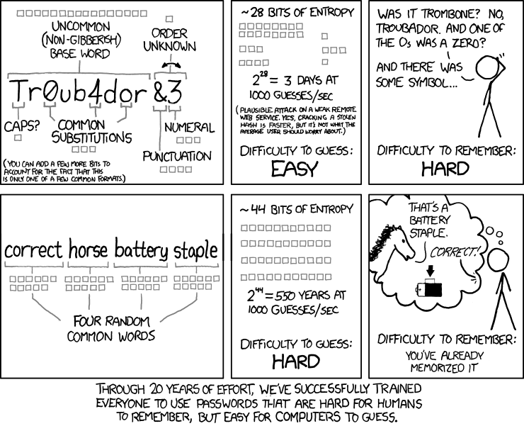
From xkcd.com

Slide 21
Two Step Verification
Recent events have brought poor authentication processes into sharper view, and drawn attention to a new way of managing the risks associated with password authentication
Two step verification is a process where the user logs in as normal with a username/password combination, and a 2nd verification token is sent to some device or account, valid for a very short amount of time (30 seconds or so)

Slide 22
Finally Test Your Password
Make sure it isn’t in the “common list of passwords.txt”
Try running password hacking tools
John the Ripper
Cain & Abel

Slide 23
Consequences
Improper password management has lead to many failed systems
User accounts info gleaned from other hacks are used to gain system access to databases or admin access to servers
One compromise can lead to others

Slide 24
Consequences
Criminal/tortious consequences
Ashley Madison – divorce and suicide
Embarrassment
Brand integrity

Slide 25
Online checking tools
You can go to https://haveibeenpwned.com/ to verify if your credentials have been compromised.
Passwords may be compromised on these sites as well, even if you haven’t found your password in an online dictionary.

